Slide 1




MLOps Overview
Confidential. ©2019 DataRobot, Inc. – All rights reserved
Notes:
NOTES:
Customize the opening slide with your name and contact info.
TALKING POINTS:
Thank you for your time – I promise to make this worth your time.
We’re in an exciting time for business. Business rules are being re-written. Companies are in a race to adopt AI and machine learning.
AI and machine learning are hard, but today I’m going to show you how your company can become AI-driven, with a technology we created called automated machine learning.

Slide 2
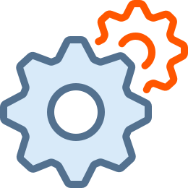




What is MLOps?
Machine Learning Operations (MLOps) technology and practices provide a scalable and governed means to rapidly deploy and manage ML applications in production environments.
MLOps
Data Scientists
IT Operations

Slide 3




Critical Barriers for AI Adoption at Scale
Difficult Production Deployment
Insufficient Monitoring
Costly Model Updates
Lack of Governance
Variety of ML tools across teams make collaboration between data science and IT difficult
ML model behavior is difficult to track with traditional software tools
Models have a complex lifecycle that takes time away from new data science projects
Governance is required to minimize risk and ensure compliance with regulations

Slide 4






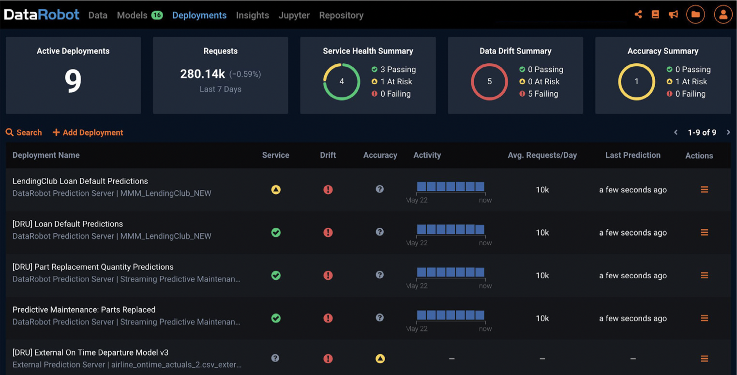




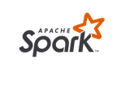
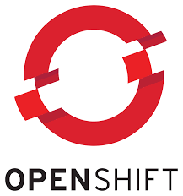


DataRobot MLOps - One Place to Manage All Your ML Running in Production
Team 1
Team 2
Team 3
Team 4
Team 5
Build – Use a Variety of Data Science Tools to build AI models
Operate– Unify the Deployment, Monitoring, Management and Governance of Production AI
Deployment
Monitoring
MLOps
Governance
Management
Run – Use the best Environment for each AI Application

Slide 5






MLOps for AI Adoption at Scale
Production Model Deployment
Production Model Monitoring
Model Lifecycle Management
Production Model Governance
Deployment for variety of models written in leading platforms and languages
Tracking and alerts for data drift and ML specific metrics
Support for model retraining, updates and replacement
Production model access control, auditing and model lineage

Slide 6
The DataRobot MLOps Advantage
Finally deliver the value of AI by easily deploying and managing models from multiple ML platforms in production
Proactively manage production models to prevent production issues and ensure model trust
Safely scale AI projects and maintain control over production models to minimize risk and comply with regulations

